Slide 1

TELANGANA TOURISM
-Providing Insights for Telangana Government Tourism Department

Slide 2
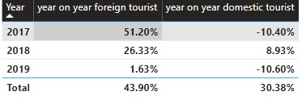
Year on Year Growth Analysis
There has been a positive growth in the number of foreign visitors across the timeline, but for domestic visitors, it is a negative trend except for 2018 where there was 8.93% growth as compared to previous year. For the foreign visitors, minimum growth was seen in 2019, which was just 1.63% more as compared to 2018.

Slide 3
Weekday/Weekend Analysis
Total Visitors on Weekdays are 2.7 bn, generating an overall revenue of 329 bn across all the years whereas Total Visitors on Weekends are 8.5 crs, generating an overall revenue of 104 bn across all the years. 75.9% of total revenue from weekdays (5 days per week) and 24.01% from weekends (2 days per week)

Slide 4
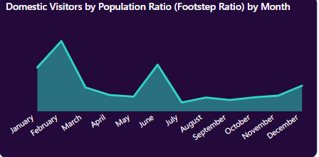
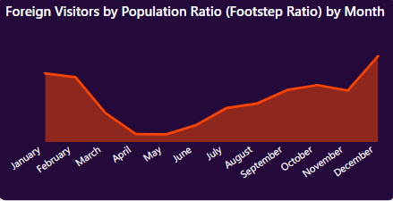
Peak Seasons/Off Seasons Analysis
Jan-Mar and June-July has seen a peak in total number of visitors as compared to other months of the year. The trend remains the same for the domestic visitors but foreign visitors like visiting these places towards the end of the year(Oct-Jan)
Suggestion: We can plan for more tourist attracting events like star performance shows, musical nights,beach festivals,etc during off seasons. For the peak seasons, we can look for more stay packages,coupons, vouchers, campings,etc. This will help us generate more revenue.

Slide 5
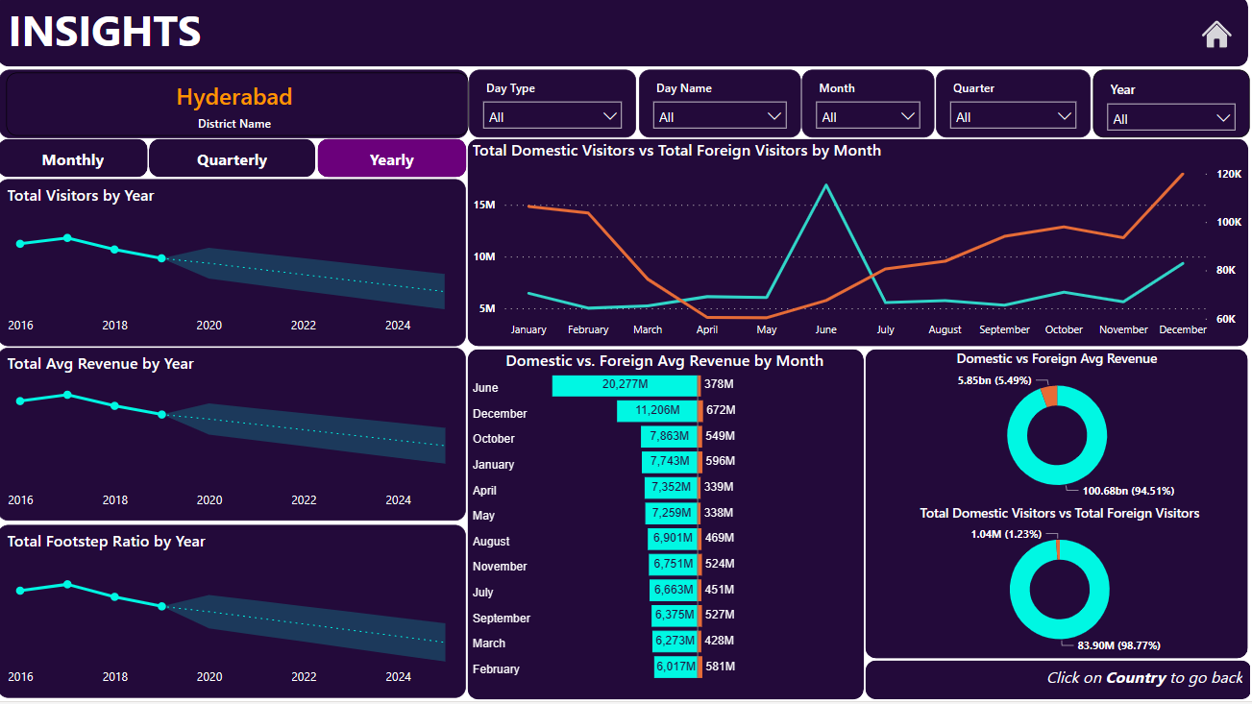
Trend Analysis
District-Hyderabad
Based on the previous datapoints, we can see that in 2025, there is a decreasing trend projected. This would help us to plan better for increasing the revenue and attract more tourists.
Domestic- Peak: May-July, Off: Jan-March
Foreign- Peak: Oct-Jan, Off: Apr-May
We can provide tourist packages, offers on hotel stays, coupons and vouchers, etc. in peak seasons, whereas we can plan for star nights, cultural programs, food fests, beach festivals during off season to attract more tourist and increase the revenue
Similar observations can be drawn district wise using drill through in powerbi

